Slide 1






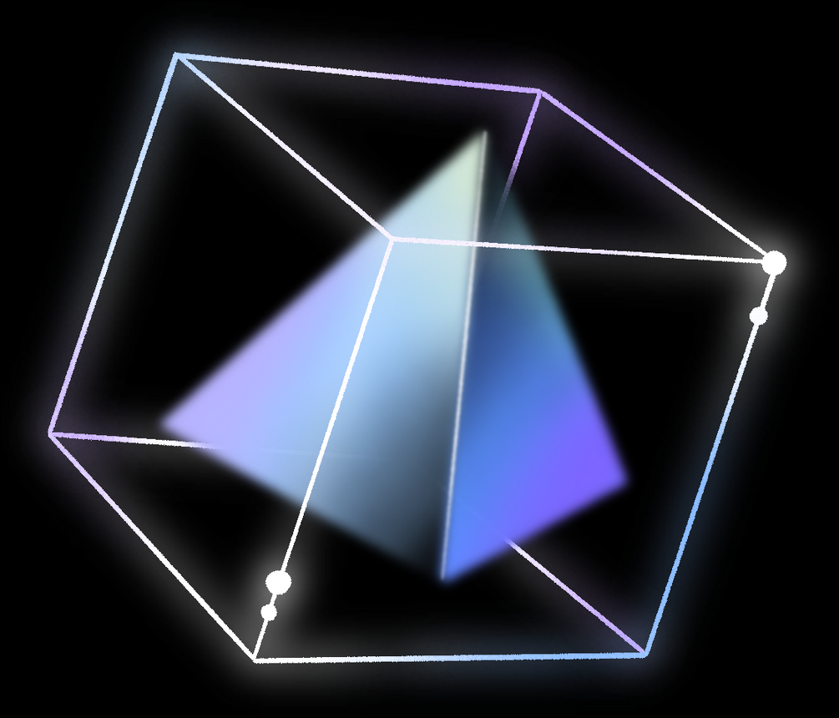
02
THÁI THÀNH PHÁT
ITITIU21274
DSA Project
01
MINESWEEPER
04
VÕ HOÀI BẢO
ITITIU21038
PHẠM TRUNG DŨNG
ITITIU21007
03
NGUYỄN ĐỨC DUY
ITITIU21008

Slide 2




CONTRIBUTOR
Tools
DSA Project
01
02
03
04
05
06
07
NGUYỄN ĐỨC NGUYÊN PHÚC
ITDSIU21108
IntelliJ IDEA
GITHUB
ECLIPSE IDE
MINESWEEPER
By Group “JQKA”
Introduction
Game Rules
UML & Git
Data Structure & Algorithm
Features & Design Pattern
Demo
Q&A
Introduction
Game Rules
Git
Data Structure & Algorithm
UML & Other classes
Demo
Q&A

Slide 3
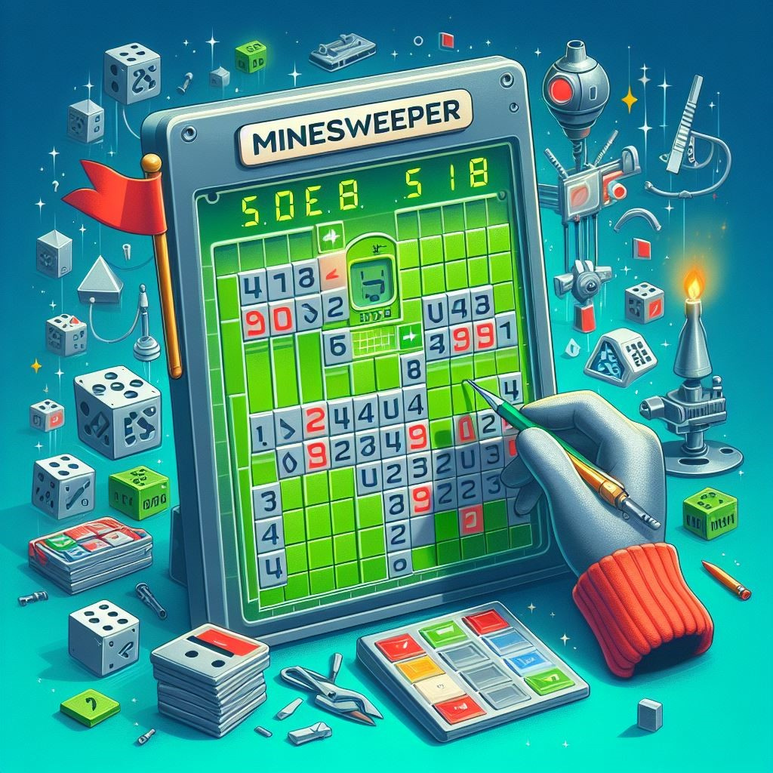



TABLE OF CONTENTS
Introduction
Game Rules
UML & Git
Data Structure & Algorithm
Design Pattern
Demo
01
02
03
04
05
06
01
02
03
04
VÕ HOÀI BẢO
ITITIU21038
THÁI THÀNH PHÁT
ITITIU21274
NGUYỄN ĐỨC DUY
ITITIU21008
PHẠM TRUNG DŨNG
ITITIU21007
INTRODUCTION
CODED BY JAVASCRIPT
- A Childhood game.
- Use intelligence to figure out the bombs.

Slide 4
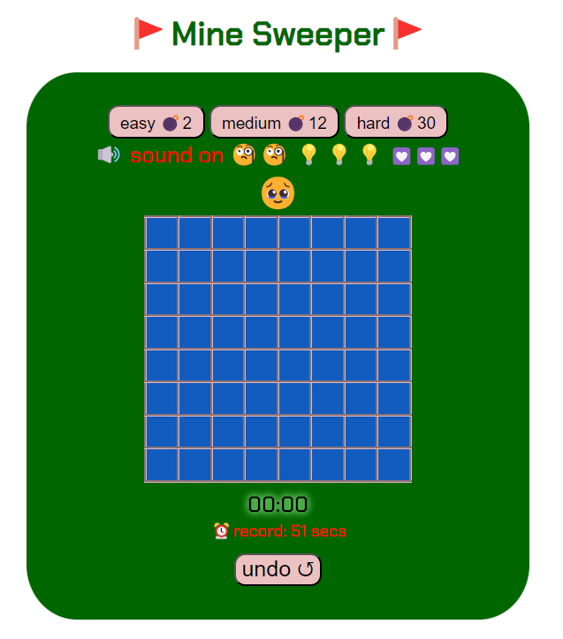


Introduction
Game Rules
UML & Git
Data Structure & Algorithm
Features & Design Pattern
Demo
Q&A
01
02
03
04
05
06
07
- Left Click to unlock a square
- Right Click to place a flag
- Click on the bomb -> LOSE !
INTRODUCTION
CODED BY JAVA
A game of logic.
Make use of your intelligence to locate the mines.
GAME RULES
TABLE OF CONTENTS

Slide 5


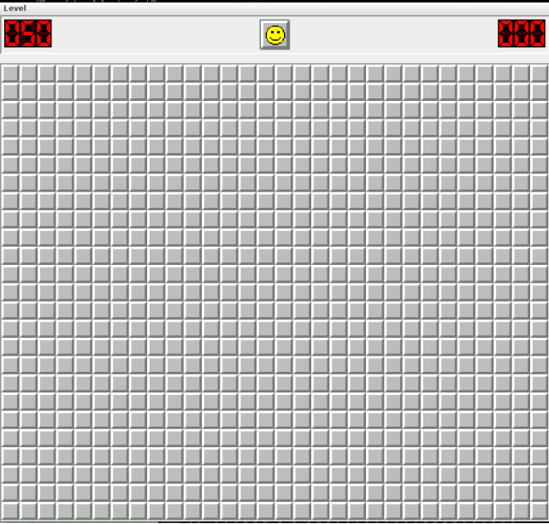
GAME RULES
Right Click to reveal a cell
Left Click to place a flagging or unflagging
Click on the bomb -> LOSE !
3 Levels: Beginner, Intermediate and Hard

Slide 6
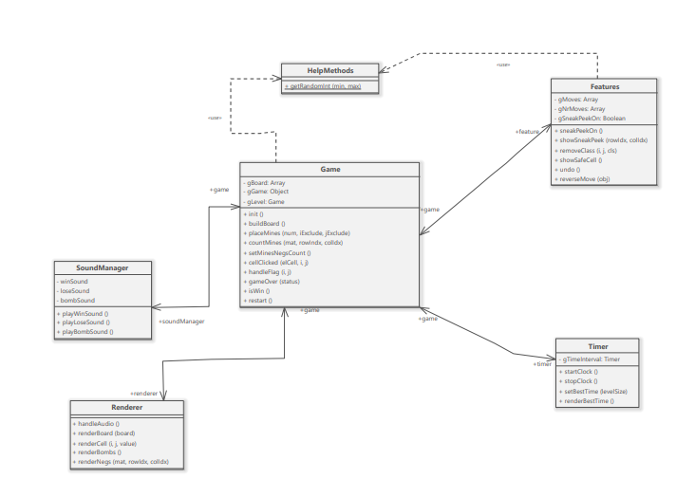


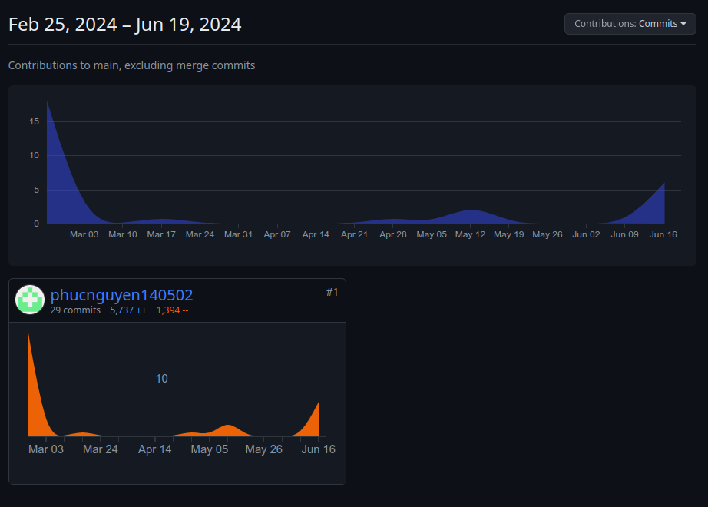

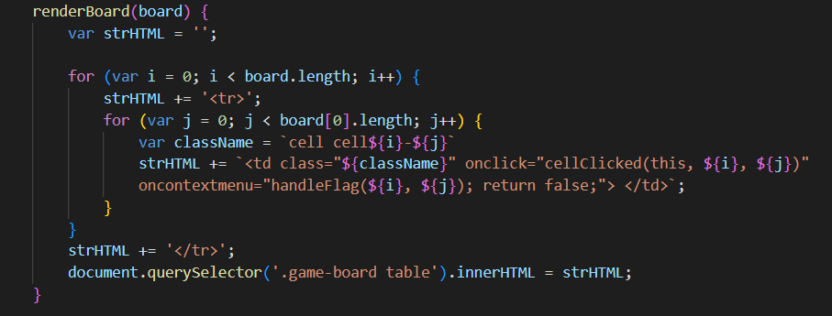

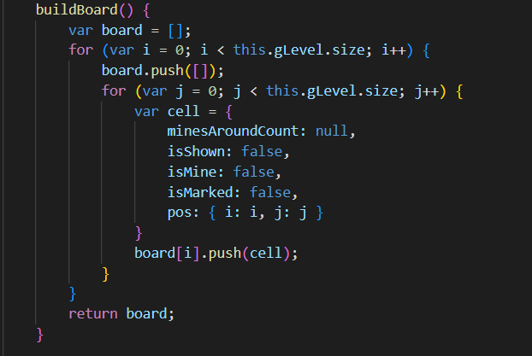

DATA STRUCTURE & ALGORITHM
GIT CONTRIBUTION
01
02

Slide 7
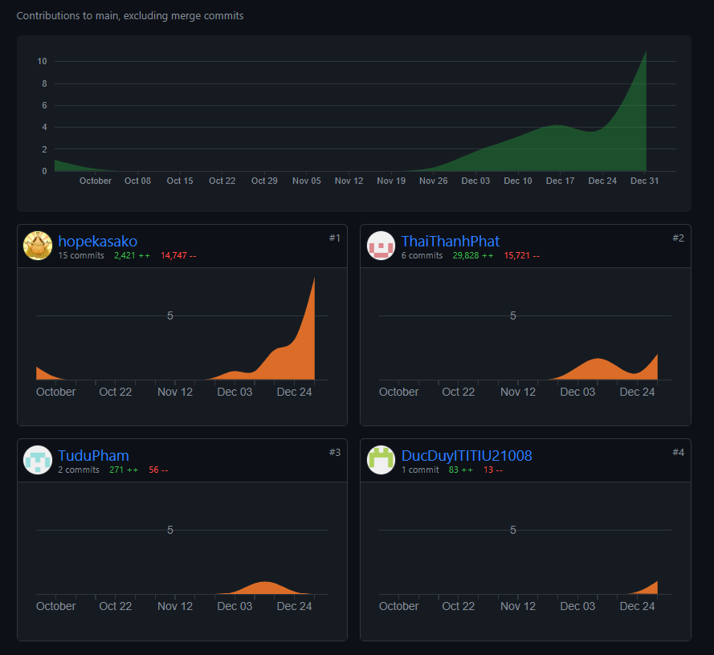
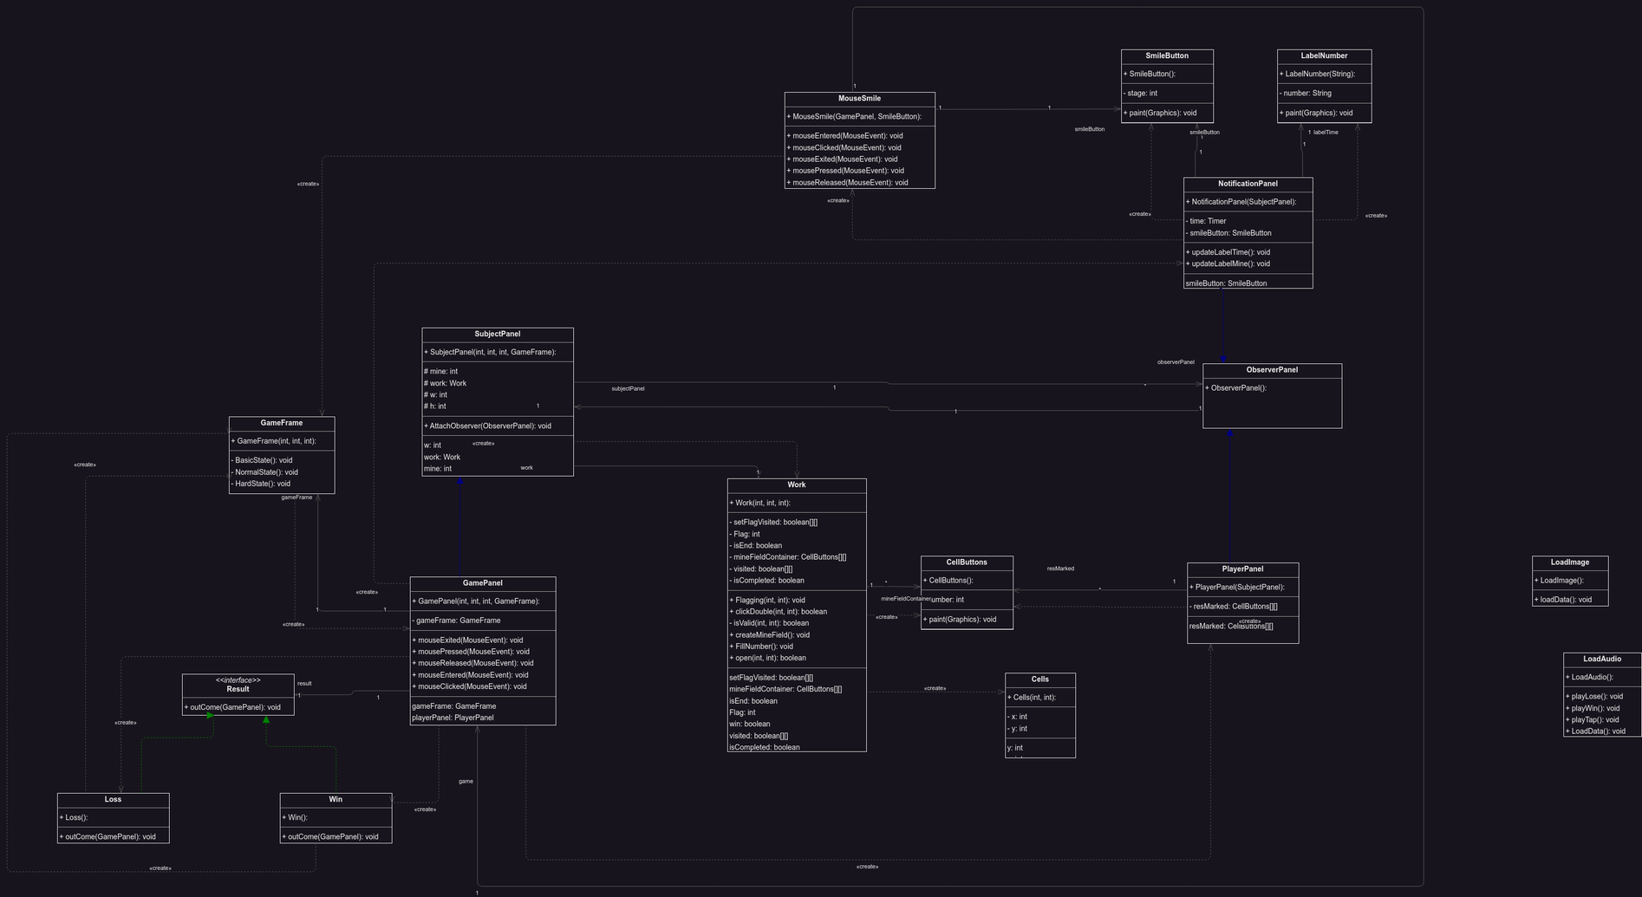
DATA STRUCTURE & ALGORITHM
UML
- Left Click to unlock a square
- Right Click to place a flag
- Click on the bomb -> LOSE !
GIT CONTRIBUTION
Time complexity : O(N^2)

Slide 8

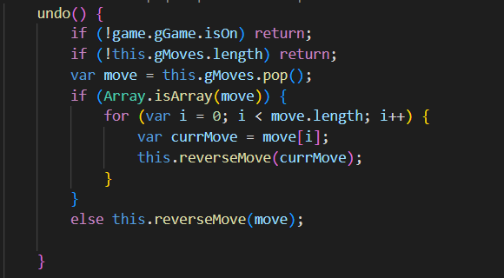
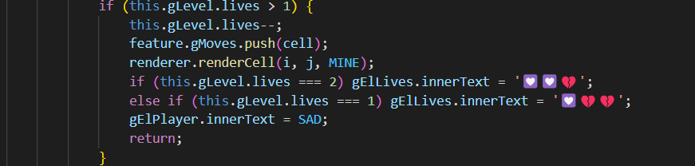
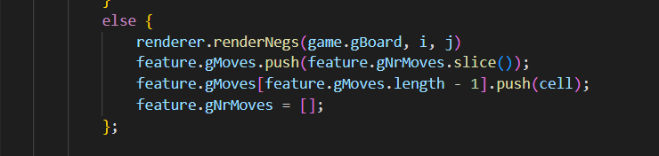
DATA STRUCTURE & ALGORITHM
DATA STRUCTURE & ALGORITHM
Applying Advanced Graph (BFS)
The algorithm in class work
click work.java to see
Time complexity : O(N^2)
GIT CONTRIBUTION

Slide 9
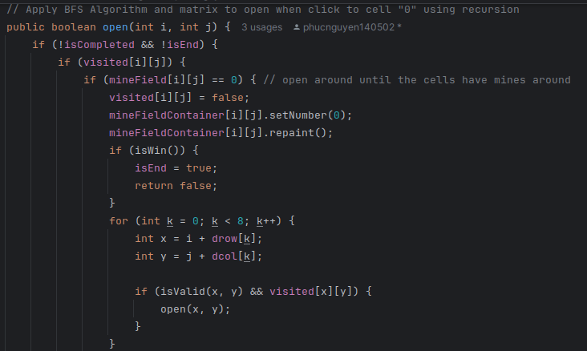
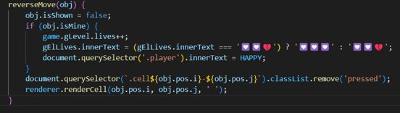
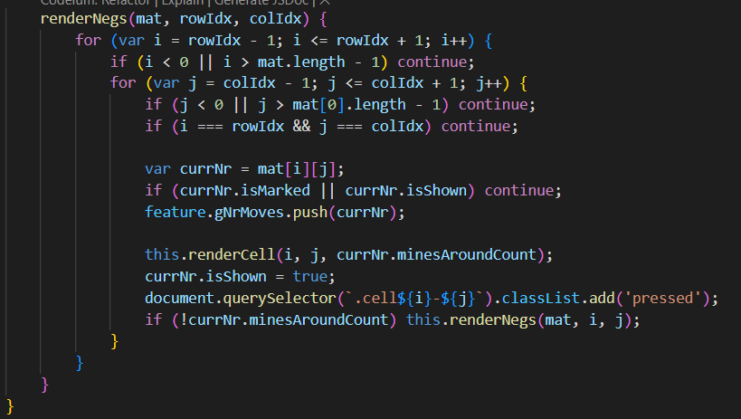
DATA STRUCTURE & ALGORITHM
DATA STRUCTURE & ALGORITHM
Applying Recursion
Time Complexity : O(N^2)
DATA STRUCTURE & ALGORITHM

Slide 10
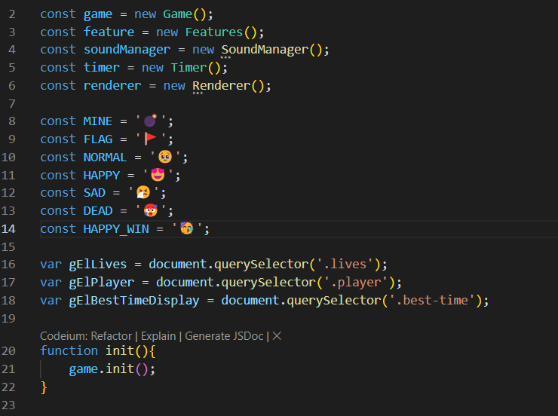
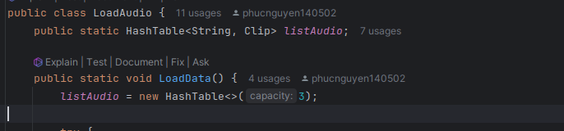
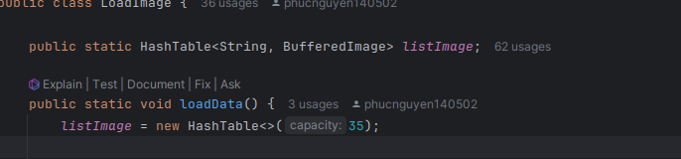
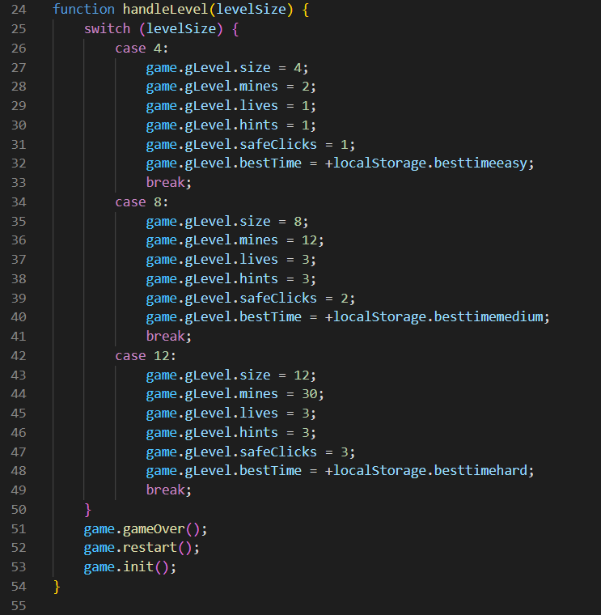
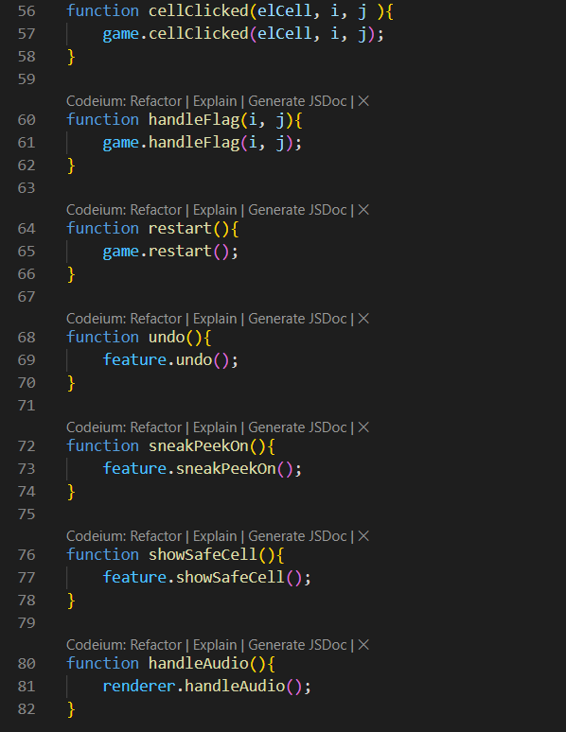
Time Complexity : O(1)
script.js
DATA STRUCTURE & ALGORITHM
Applying HashTable
Time Complexity : O(1)
DATA STRUCTURE & ALGORITHM

Slide 11
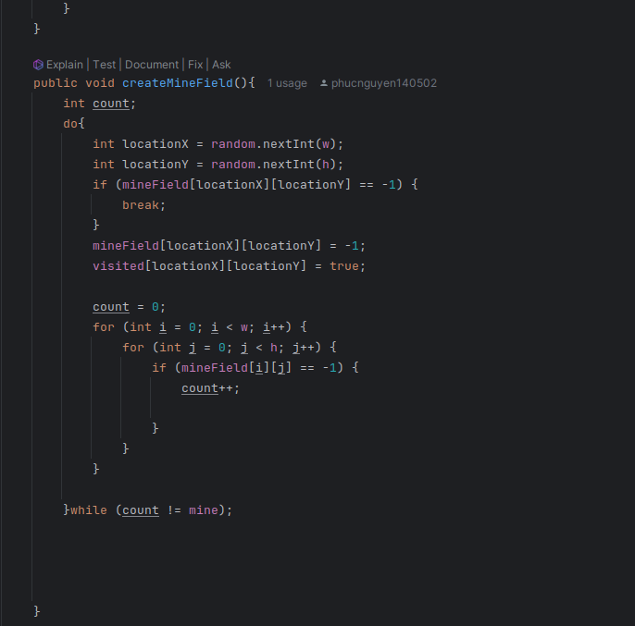
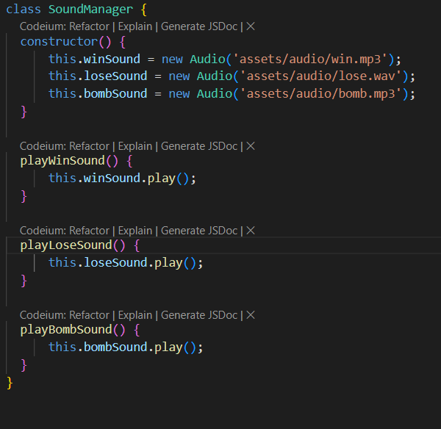
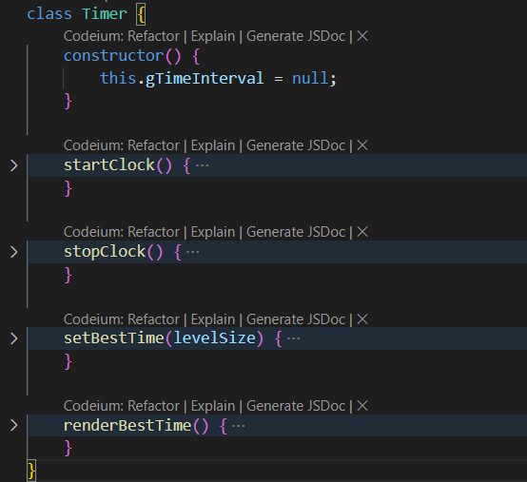
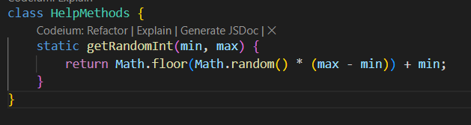




Create the board
Time Complexity : O(w*h)
Other Classes

Slide 12
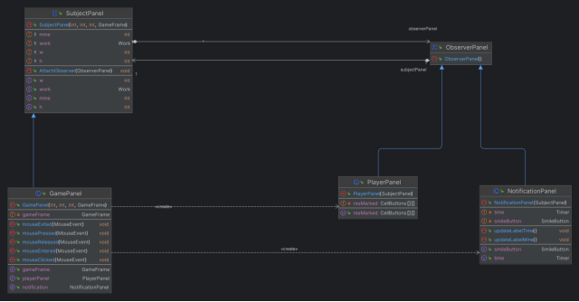
Observer Design Pattern

Slide 13
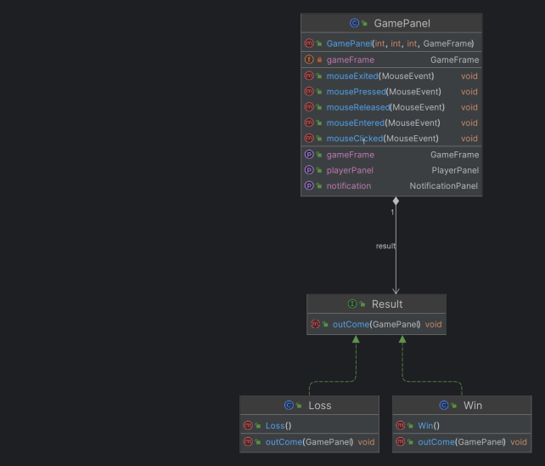
Strategy Design Pattern

Slide 14


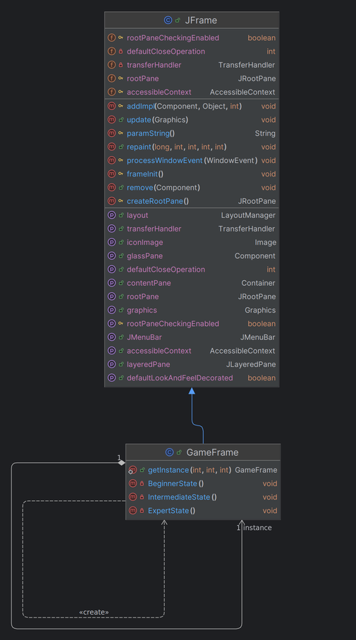
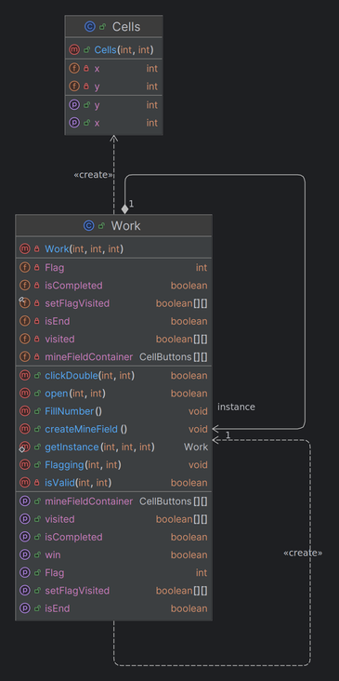



Singleton Pattern
GAME DEMO

Slide 15

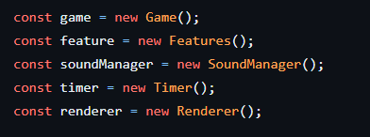
THANK YOU
FOR LISTENING !
GAME DEMO
Singleton Pattern
Q&A TIME!

Slide 16
02
THÁI THÀNH PHÁT
ITITIU21274
Thank you for listening
01
04
VÕ HOÀI BẢO
ITITIU21038
PHẠM TRUNG DŨNG
ITITIU21007
03
NGUYỄN ĐỨC DUY
ITITIU21008
Q&A TIME!

Slide 17




RESOURCE PAGE

